Slide 1
Identify good journal and good keywords
Final Project Report, Springboard
Presenter: Weina Ke
Mentor: Raghunandan Patthar
7/30/2023

Slide 2
Problem Statement: -Why are I interested in finding good journal and keywords?
Literature review: Gathering research papers for basic knowledge base
Choosing the right journal for publication
Impact Factor (IF) as a measure of journal popularity
Challenges in finding credible sources and understanding IF

Slide 3
Data Search Tools
Different tools based on available sources (institution subscriptions, Google Scholar)
Introduction to Exaly (https://exaly.com/)
Exaly as a comprehensive and unbiased bibliographic database
Web scraping capabilities for gathering journal information

Slide 4
Method
Researching the field of nanomaterial for cancer research
Data collected:
Journal name
Total article number
Total citation number of the journal
Most cited article title
Published year of the most cited article
Most cited article citation number
Keyword used to search the article
Impact factor

Slide 5
Data Cleaning
Keyword Formatting and Initial Exploration
Formatting the dataset for analysis
Creation of new keyword columns
Examining keyword presence in article titles and journal names
Dropping non-representative columns
I gathered information for 2072 unique journals searched with keywords: "theranostic", "nanomedicine", "nanodevice", "nanotechnology", "delivery", "diagnosis", "treatment", "cancer", "therapeutic", "antitumor", "nanostructure", "nanoparticle", "therapy", "tumor", "nanocarrier", "imaging", "nanoformulation", "target" paired with "cancer".

Slide 6
Exploratory Data Analysis (EDA)
Analysis of keyword search results
Impact factor distribution
Most cited articles and their publication years
Understanding keyword overlap and relationships

Slide 7
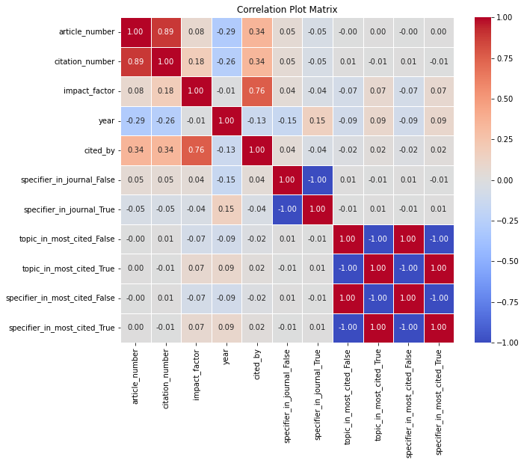
Exploratory Data Analysis (EDA)

Slide 8
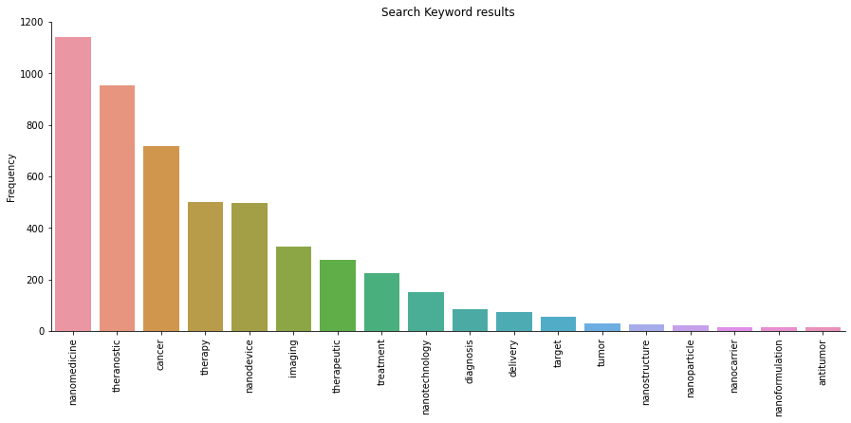
Exploratory Data Analysis (EDA)

Slide 9
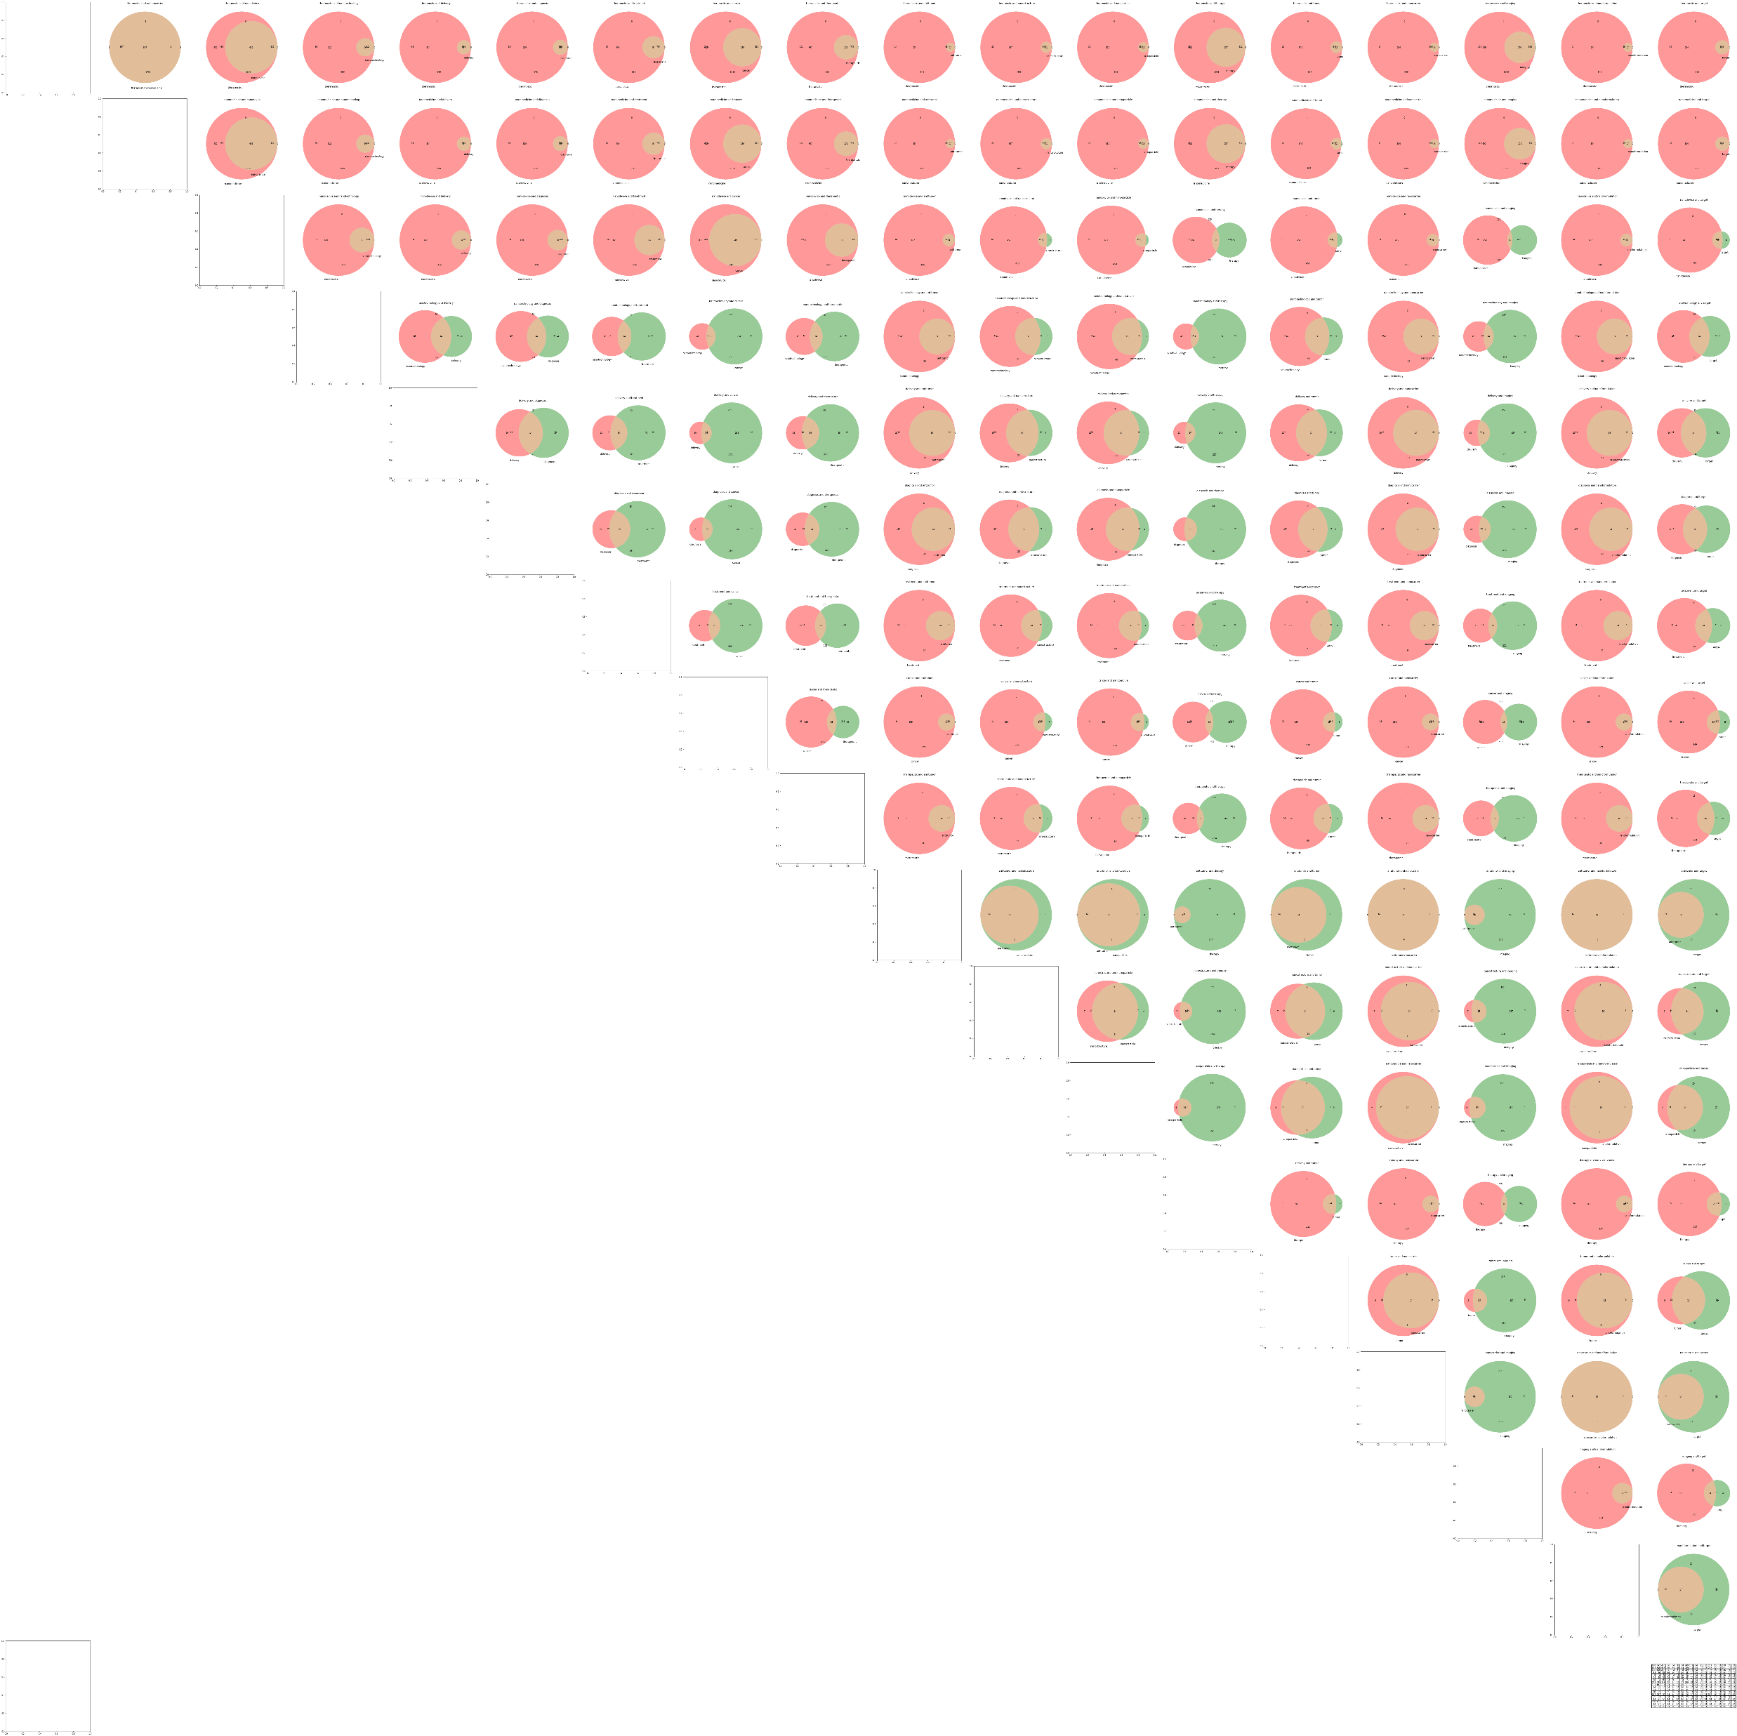
Keyword Pairwise Venn Diagram
Visual representation of keyword overlap
Identifying independent and overlapping keyword pairs

Slide 10
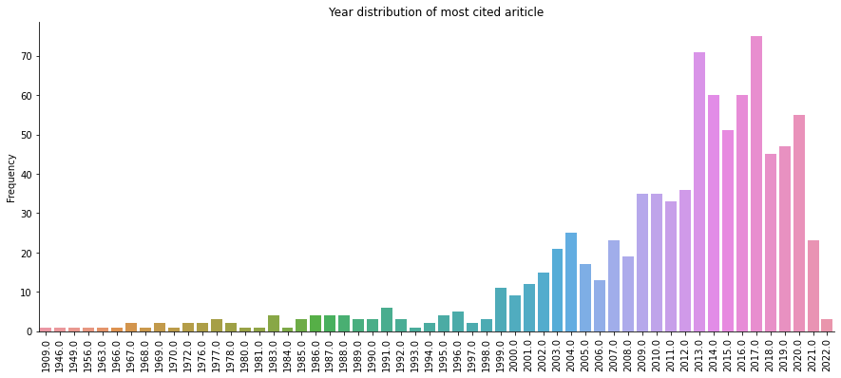
Year Distribution of Most Cited Articles
Analysis of publication years of most cited articles
Indication of field growth and active research

Slide 11


Word Cloud of Journal Names
Visual representation of journal names in the dataset
Frequency of occurrence of different journal names

Slide 12
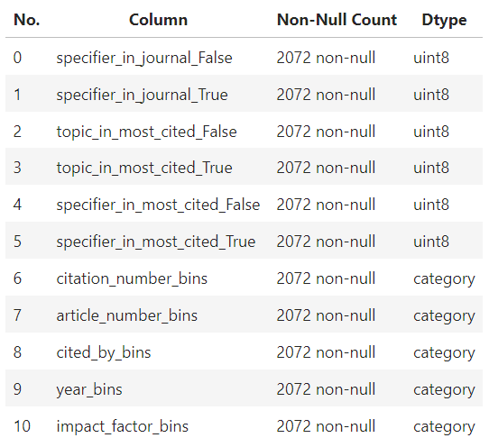
Models
Introduction to Decision Tree Classifier, Random Forest Classifier, and Random Forest Regressor
Dataset structure for modeling and training
Model performance and accuracy evaluation

Slide 13
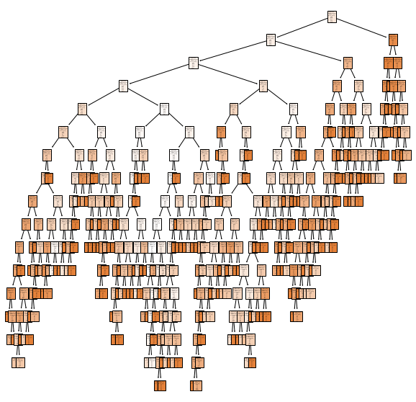
Decision Tree Classifier
Decision tree visualization
Interpretation of complex decision-making process
Accuracy: 0.78

Slide 14
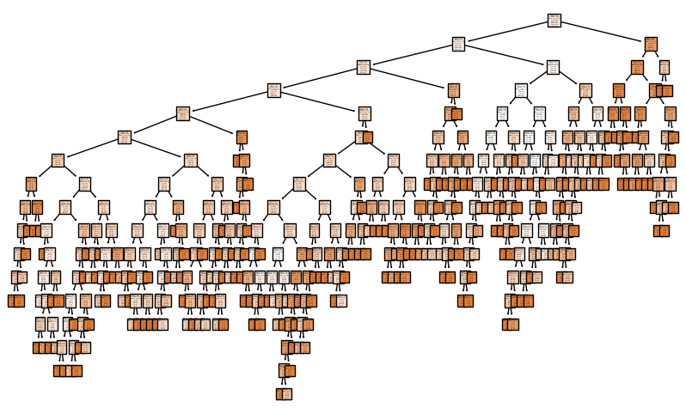
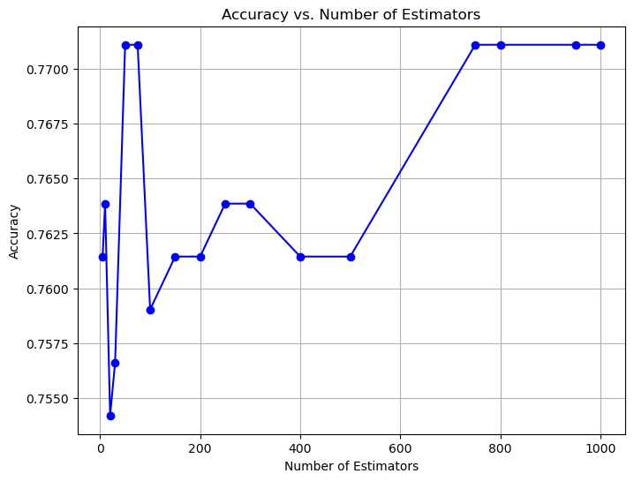
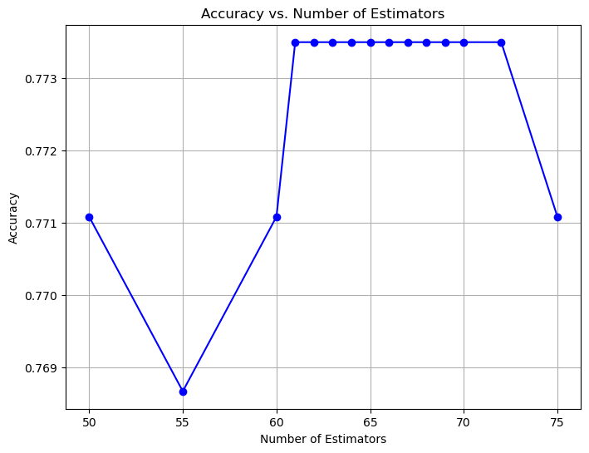
Random Forest Classifier
Optimum number of estimators for random forest
Balancing accuracy and computational resources
Accuracy 0.76.

Slide 15
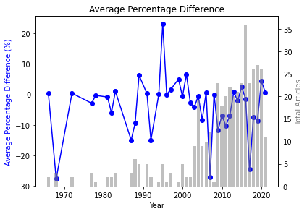
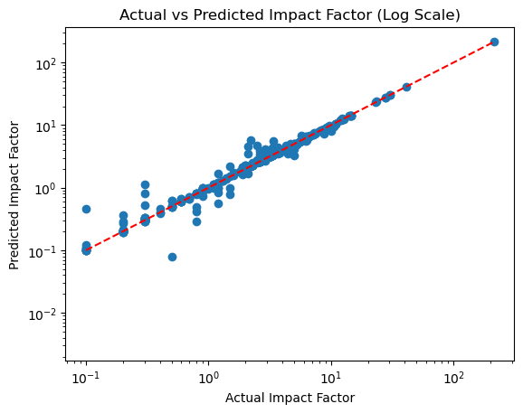
Random Forest Regressor
Predicting impact factor using regression
Evaluation metrics:
Mean Squared Error: 0.153
Mean Absolute Error: 0.156
R-squared: 0.999

Slide 16
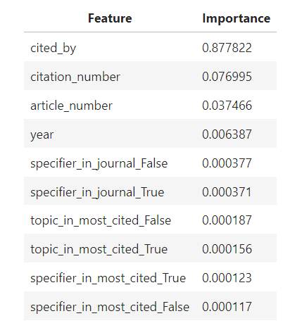
Feature Importance
Determining factors influencing impact factor prediction
Importance of cited_by, citation_number, and article_number

Slide 17
Summary of Models
Decision Tree Classifier: Accuracy of 0.78
Random Forest Classifier: Accuracy of 0.76
Random Forest Regressor: MSE of 0.153, MAE of 0.156, R-squared of 0.999

Slide 18
Future Improvements
Include more keywords to improve coverage of the field
Seek feedback from experts for keyword selection
Add a recommendation rating for journals
Explore the evolution of impact factors over time and across fields

Slide 19
Conclusion
Literature review and journal selection are crucial steps in research
Impact Factor provides insights into journal popularity
Data-driven approach can assist in understanding journal quality
Further improvements and exploration can enhance the research process

Slide 20
Thank You!
Questions and Discussion

Slide 21
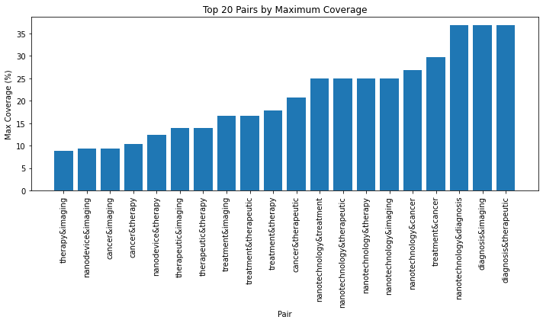
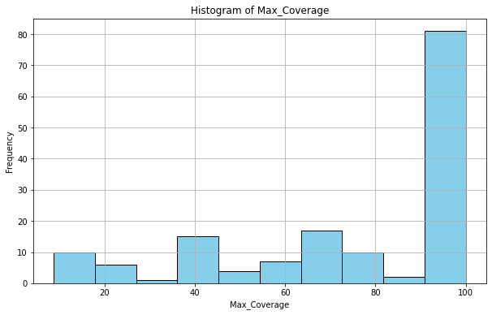
Supplementing Materials

Slide 22
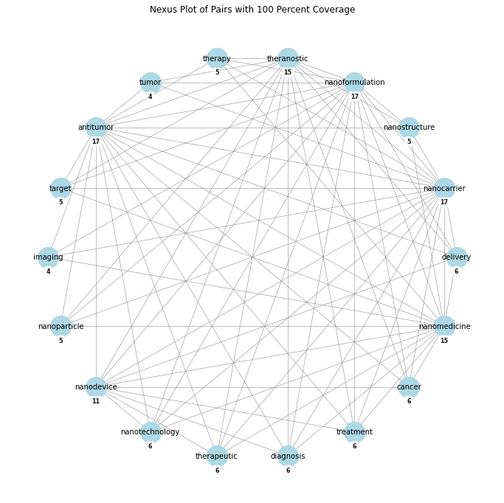
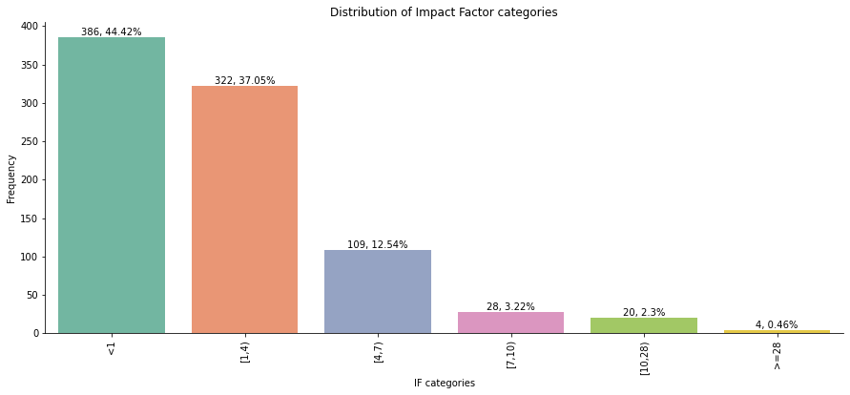
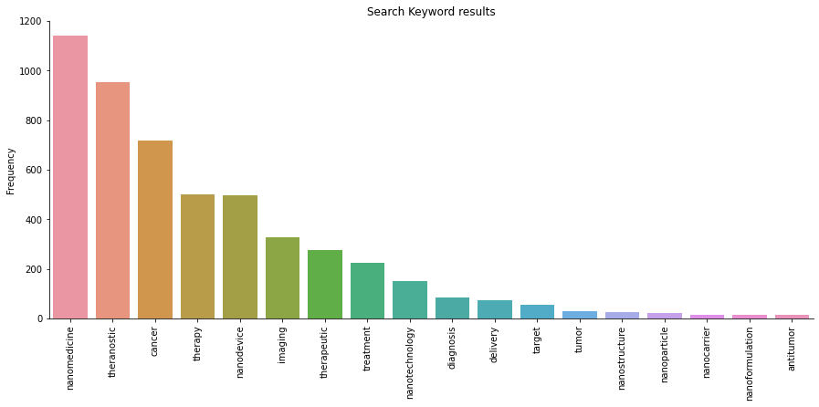
Supplementing Materials

Slide 23
Uni Variate Analysis
article_number | citation_number | impact_factor | year | cited_by | specifier_in_journal_False | specifier_in_journal_True | topic_in_most_cited_False | topic_in_most_cited_True | specifier_in_most_cited_False | specifier_in_most_cited_True | specifier_in_most_cited_True
count | 2072.00 | 2072.00 | 2072.00 | 2072.00 | 2072.00 | 2072.00 | 2072.00 | 2072.00 | 2072.00 | 2072.00 | 2072.00
mean | 2327.30 | 76615.67 | 3.87 | 2011.11 | 840.97 | 0.79 | 0.21 | 0.39 | 0.61 | 0.39 | 0.61
std | 5773.22 | 293695.94 | 13.07 | 9.87 | 3097.47 | 0.41 | 0.41 | 0.49 | 0.49 | 0.49 | 0.49
min | 11.00 | 0.00 | 0.00 | 1966.00 | 0.00 | 0.00 | 0.00 | 0.00 | 0.00 | 0.00 | 0.00
25% | 96.00 | 110.75 | 0.30 | 2009.00 | 17.00 | 1.00 | 0.00 | 0.00 | 0.00 | 0.00 | 0.00
50% | 364.00 | 2700.00 | 1.90 | 2014.00 | 128.00 | 1.00 | 0.00 | 0.00 | 1.00 | 0.00 | 1.00
75% | 2100.00 | 30300.00 | 4.30 | 2017.00 | 548.00 | 1.00 | 0.00 | 1.00 | 1.00 | 1.00 | 1.00
max | 53900.00 | 3400000.00 | 214.00 | 2022.00 | 40300.00 | 1.00 | 1.00 | 1.00 | 1.00 | 1.00 | 1.00

Slide 24
Feature Engineering – Categorical Conversion
Percentiles for variables: [50, 80), [80, 90), [90, 95), [95, 99), [99, 100)
Boundary of 'citation_number_bins': [62, 687, 6500, 48200, 3400000]
Boundary of 'article_number_bins': [66, 233, 822, 2500, 53900]
Boundary of 'cited_by_bins': Int64Index[13, 71, 226, 667, 40300]
Categories of 'year_bins':['1966-1970', '1971-1975', '1976-1980', '1981-1985', '1986-1990','1991-1995', '1996-2000', '2001-2005', '2006-2010', '2011-2015', '2016-2020', '2021-2025’]
Percentiles for variables: [0, 50),[50, 80), [80, 90), [90, 95), [95, 99), [99, 100) Impact factor values ['0-0.99', '1-3.99', '4-6.99', '7-9.99', '10-27.99', '28-213.99']

Slide 25
Chi-Square of categorical columns, P-value
 | citation_number_bins | article_number_bins | cited_by_bins | year_bins | impact_factor_bins
citation_number_bins | NaN | 0 | 0 | 0 | 0
article_number_bins | 0 | NaN | 0 | 0 | 0
cited_by_bins | 0 | 0 | NaN | 0 | 0
year_bins | 0 | 0 | 0 | NaN | 0
impact_factor_bins | 0 | 0 | 0 | 0 | NaN

